Slide 1
Passage-based scoring and passage retrieval
Harisankar Prusty(001351919)
Janice Lu(001404529)

Slide 2
Scope of the project
In this project, we will implement a passage retrieval engine which aims to deliver a set of passages that are most likely to contain a relevant response to a query.
The passage retrieval engine can be applied in Question Answering systems where a short and precise answer should be returned to a human natural language question rather than a full list of documents and web pages.

Slide 3
Steps to be covered
Experiments of subdividing a document:
By Paragraphs
By Clustering semantically similar sentences
By only sentences
And also indexing the data collection by passages

Slide 4
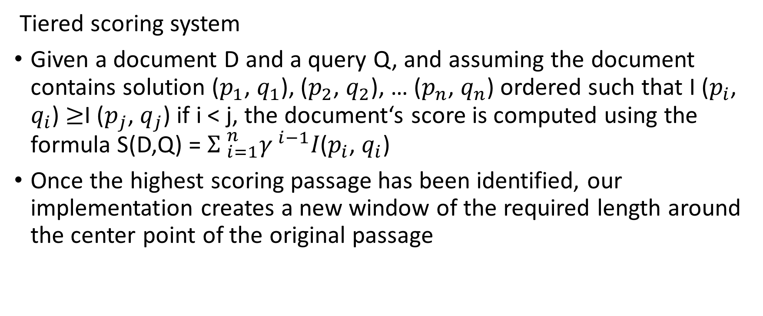
Strategy to combine passage score
Tiered scoring system
Given a document D and a query Q, and assuming the document contains solution ($p_{1}$, $q_{1}$), ($p_{2}$, $q_{2}$), … ($p_{n}$, $q_{n}$) ordered such that I ($p_{i}$, $q_{i}$) $≥$I ($p_{j}$, $q_{j}$) if i < j, the document‘s score is computed using the formula S(D,Q) = ${Σ }_{i=1}^{n}{γ }^{i−1}I\text{(}p_{i}\text{, }q_{i}\text{)}$
Once the highest scoring passage has been identified, our implementation creates a new window of the required length around the center point of the original passage
Notes:
how close keywords appear to each other
geometric \decay“ paramete
Document scores are composed of passage scores contained in them.

Slide 5
Methods to retrieve and re-rank passages
Passages will be retrieved by using different algorithms (core principle is to rely on the dependency degree of n-gram words of the query in the passage to retrieve correct passages)
N-grams
Tf-idf
Bm25
MultiText
Different model are used to improve passage ranking incorporating various lexical, syntactic and semantic similarity measures. As listed below:
SVM
Gradient boosting decision tree
Random forest etc.

Slide 6
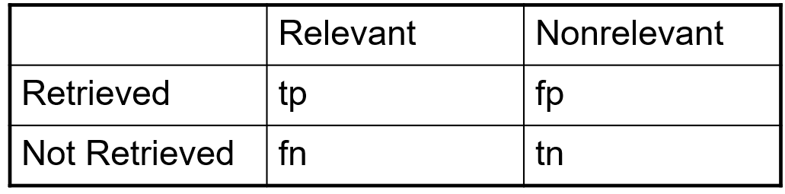
Evaluate the results of passage retrieval models
Precision: fraction of retrieved docs that are relevant = P(relevant|retrieved)
Recall: fraction of relevant docs that are retrieved
= P(retrieved|relevant)
Precision P = tp/(tp + fp)
Recall R = tp/(tp + fn)

Slide 7
Precision/Recall
You can get high recall (but low precision) by retrieving all docs for all queries!
Recall is a non-decreasing function of the number of docs retrieved
In a good system, precision decreases as either the number of docs retrieved or recall increases
This is not a theorem, but a result with strong empirical confirmation

Slide 8
Work distribution
Distribution of work | Harisankar | Janice
Experiments of subdividing a document(part 1) | Hari(Setting up the lucene baseline, dividing by passages)
Experiments of subdividing a document(part 2) |  | Janice(dividing the documents into sentences or clusters, indexing by passages)
Strategy to combine passage score |  | Janice
Methods to retrieve passages | Hari
Methods to rank passages |  | Janice
Evaluate the passage retrieval engine | Combined | Combined

